Slide 1


Public Health Infrastructure & Functions
Dr Hilda Mulrooney (with thanks to Afshan Aghili)

Slide 2

Aims of lecture today
Introduce you to:
The role of Public Health England (UK Health Security Agency)
Public health infrastructure & functions
Public health outcomes framework

Slide 3
Learning Outcomes
Gain understanding of the role of Public Health:
Its core functions & Public Health Outcome Framework (PHOF)
Recognise the wider determinants of health
Recognise the reports related to health inequalities

Slide 4
What is Health?
The WHO definition of health, formulated in 1948, described health as:
  “a state of complete physical, mental and social well-being and not merely the absence of disease or infirmity”
  Much criticism over this definition as the requirement for complete health “would leave most of us unhealthy most of the time”

Slide 5
More recent definition
Health includes:
    Physical Health,
    Mental Health and
    Wellbeing
Notes:
Formulation of health: ‘the ability to adapt and to self manage’?

Slide 6
What is wellbeing?
Wellbeing includes:
How we feel
How we think
Relationships
Meaning & Purpose (Friedli 2009)
Benefits:
  Reduced health risk
  Reduced mortality
  Improved educational outcomes
  Increased productivity at work

Slide 7

Influences on health
Age
Genetics/ history
Behaviour/ lifestyle
Environment
Social
Economic
Cultural
Psychological
Notes:
Health is multi-factorial & influenced by factors such as:
Genetics/family history of disease
Behaviour/lifestyle e.g. smoking, alcohol, diet, physical activity, sexual behaviours, drug taking
Economic e.g. poverty, employment status, access to employment opportunities, quality & security of employment, housing stability & quality (homelessness)
Environmental e.g. living conditions, pollution, access to green spaces, crime, transport
Social e.g. education, social inclusion or exclusion
Cultural factors e.g. cultural norms
Psychological e.g. ability to manage stress

Slide 8
Widely Used Terms in PH
  Social determinants of health
  Health inequalities
  Life course
  Public Health Outcomes Framework (PHOF)

Slide 9
Health Inequalities defined
“Differences in health status or in the distribution of health determinants between different population groups.”
WHO believes:
“avoidable health inequalities arise because of inequalities in society and in the conditions in which we are born, grow, live work and age, and the systems put in place to deal with illness. The conditions in which people live and die are, in turn, shaped by political, social and economic forces.”

Slide 10
  Social determinants of health – the social and economic conditions in which people are born, grow, live, work and age, including the health system.
  Health inequalities – differences in the health (and increasingly wellbeing) experienced by different groups in a community which are avoidable and therefore held to be unacceptable.

Slide 11

Life Course
  An approach to health emphasising the overall effects of an individual’s experience across their life span:
  maintenance of health & prevention of disease,
  poor economic & social conditions in the very early years can adversely impact individuals’ growth and development
  increase risk of disease & ill health in later life & life expectancy (e.g. Gracner et al, 2024 https://www.science.org/doi/epdf/10.1126/science.adn5421)

Slide 12



Health Inequalities
  Black Report (1980)
  Acheson report (1998)
  Commission on the Social Determinants of Health (WHO, 2008).
  Marmot Report (2010)
Notes:
‘The Commission calls on the WHO and all governments to lead global action on the social determinants of health with the aim of achieving health equity. It is essential that governments, civil society, WHO, and other global organizations now come together in taking action to improve the lives of the world’s citizens. Achieving health equity within a generation is achievable, it is the right thing to do, and now is the right time to do it.’

Slide 13
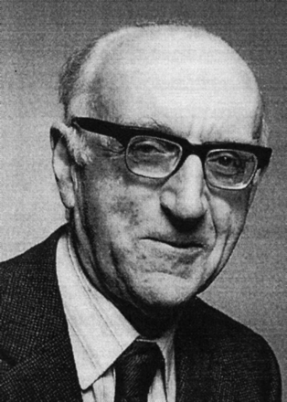
The Black Report - did it deserve attention?
Published by Dept. of Health & Social Security (1980)
Written by the expert committee into health inequality
Chaired by Sir Douglas Black (President of RCP)
Described unequal distribution of ill-health and death
Inequalities have been widening since establishment of NHS(1948)
Inequalities attributable to social inequalities influencing health
Include: income, education, housing, diet, employment, work conditions
Recommended wide strategy of social policy measures
Report heavily criticised by government Secretary of State for Social Services
Very few copies printed

Slide 14
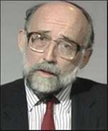
Acheson report (1998)
Independent inquiry into health inequalities
Purpose of inquiry was to inform the government's public health strategy and their policies within ‘‘Our Healthier Nation’’ paper
The Report concluded that the ‘weight of scientific evidence supports a socio-economic explanation of health inequalities’
https://assets.publishing.service.gov.uk/media/5a759e7c40f0b67b3d5c7e6f/ih.pdf
‘Poverty, low wages and occupational stress, unemployment, poor housing, environmental pollution, poor education, limited access to transport and shops, crime and disorder, and a lack of recreational facilities have had an impact on people’s health’
(Acheson 1998)

Slide 15




Key Public Health Policy Papers
  Health of the Nation (DH, 1992)
  Saving lives. Our healthier Nation (1999)
  Choosing Health: Making healthy choices easier (2004)
  Healthy Weight, Healthy Lives (DH, 2008)
  Healthy lives, healthy people (2011)- led to fundamental change in approach of PH
Notes:
monitor progress towards nationally set targets re diet and health

Slide 16

Fair Society, Healthy Lives
2010 review of health inequalities by Michael Marmot
Strongly advocates life course approach to population health, health improvement and tackling health inequalities,
First five years of life being the highest priority
https://www.parliament.uk/globalassets/documents/fair-society-healthy-lives-full-report.pdf
Notes:
Review of the ‘causes of causes’
The review, is an invaluable resource to assist with developing priorities for JHWS.
Focusing on most disadvantaged will not be sufficient - need ‘proportionate universalism’
Reducing health inequalities vital to economy - cost of inaction

Slide 17

'Fair Society Healthy Lives’ (2010)
Action on six policy objectives needed:
Every child the best start in life
Enable all children, young people and adults to maximise their capabilities & have control over their lives
Create fair employment & good work for all
Ensure healthy standard of living for all
Create and develop healthy & sustainable places and communities
Strengthen the role & impact of ill-health prevention
Government's 2011 public health white paper welcomed the review
Put reduction of health inequalities at centre of public health aims
based strategy on the Marmot review's recommendations
PHOF greatly influenced by the Marmot review

Slide 18
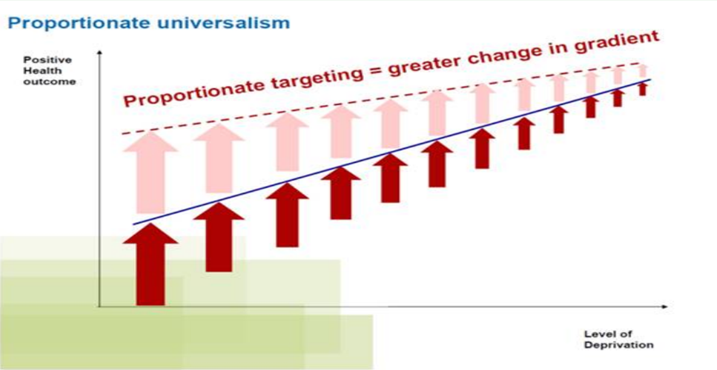
Proportionate Universalism
Sole focus on most disadvantaged will not reduce health inequalities sufficiently.
To reduce the steepness of social gradient in health, actions must be universal, at scale & intensity proportionate to level of disadvantage

Slide 19
Economic & health costs of inaction in England
Productivity losses of £31-33B
Reduced tax revenue and higher welfare payments of £20-32B
Increased treatment costs well in excess of £5B
Britain considered European nation with highest level of obesity
Worsening health inequalities between rich & poor
High rates of STDs
Large population of drug users
Increasing levels of alcohol-related harm
Smoking responsible for >80,000 lives lost pa

Slide 20

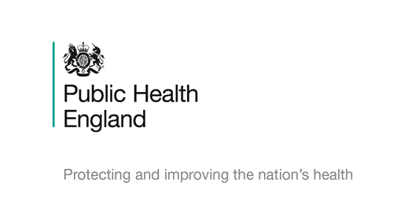
Public Health Pledge
‘We protect and improve the nation's health and wellbeing and reduce health inequalities’(https://www.gov.uk/government/organisations/public-health-England)

Slide 21


Public Health in England
Public Health England (PHE) – established April 2013; executive agency sponsored by DHSC
Set PH outcomes for local authorities
Replaced by UK Health Security Agency &
Office for Health Improvement and Disparities in April 2021, executive agencies of DHSC
UK Health Security Agency (UKHSA) - responsible for public health protection and infectious disease capability
Office for Health Improvement and Disparities (OHID) focus on improving the nation’s health
Notes:
OHID: so that everyone can expect to live more of life in good health, and on levelling up health disparities to break the link between background and prospects for a healthy life.

Slide 22
Core Functions of Public Health
  Key Areas of Public Health Practice:
  Health protection
  Infectious diseases, chemicals & poisons, radiation, emergency response, environmental health hazards
  Health & Social Care Quality
  Clinical effectiveness, efficiency, service planning, audit & evaluation, clinical governance.
  Health Improvement
  Inequalities, education, housing, employment, family/community, lifestyles, surveillance & monitoring of specific diseases & risk factors

Slide 23
PH strategic responsibility for:
    Public Health Emergencies
    Health and Wellbeing Priorities
    Health Protection
    Data and Knowledge Gateway
    Public Health Outcomes Framework

Slide 24
What is Public Health Outcomes Framework (PHOF)?
Integrated and professional PH system:
  Increase accountability for the improvement and protection of the public’s health
  Local responsibility and localism to tackle specific health needs of their populations
  Central government responsibility of protecting population’s health and safeguarding against health threats
  The outcome framework will set out how success in public health will be measured both nationally and locally

Slide 25
Public Health Outcomes Framework (PHOF)
Established 2013; reviewed every 3 yrs; vision for public health
Focus on two high level outcomes to achieve across & beyond the public health system:
1. Increased healthy life expectancy
2. Reduced differences in life expectancy and healthy life expectancy between communities
Outcomes cover length of life and how well people live at all stages of life
Notes:
Set out the Government’s goals for improving & protecting the nations’ health
Narrow health inequalities through improving the health of the poorest, fastest
Have a mechanism for transparency & accountability nationally & locally for health improvement & protection & inequality reduction

Slide 26
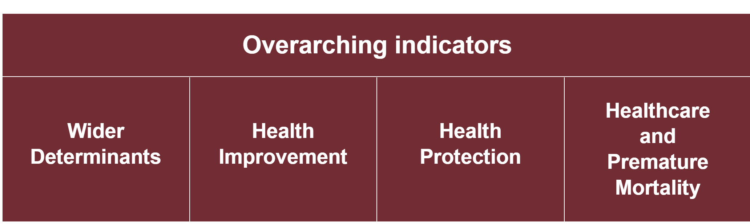
Domains
Wider determinants of health: Tackling factors which affect health, wellbeing & health inequalities
Health Improvement: Helping people to live healthy lifestyles, make healthy choices and reduce health inequalities.
Health Protection: Population’s health is protected from major incidents & other threats, whilst reducing health inequalities
Healthy life expectancy and preventable mortality: Preventing people from dying prematurely & reduce health inequalities
Notes:
Overarching indicators reported at birth and at age 65 years

Slide 27
PHOF Indicators
Set of supporting indicators within each domain to help understand the progress being made
Indicators cover the full spectrum of public health & what can be realistically measured
Every 3 years consultations take place on changes to the indicators; revised framework based on the findings is published
Wide consultation on health & social care statistical outputs (including PHOF) published 2024 (https://www.gov.uk/government/consultations/health-and-social-care-statistical-outputs/outcome/health-and-social-care-statistical-outputs-consultation-response#overarching-health-and-social-care-outputs)
Last PHOF update report November 2025
Notes:
To ensure they remain fit for purpose

Slide 28
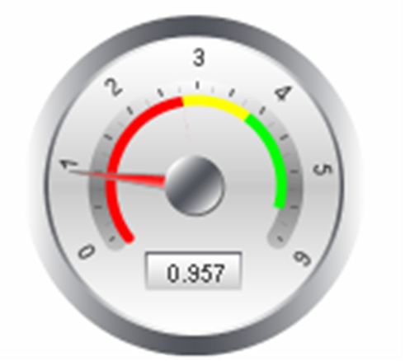

What is an indicator?
Specific, observable & measurable characteristic
Used to show changes/ progress made towards achieving specific outcome
Needs precise, unambiguous definition to describe clearly & exactly what is being measured
Selected via consultations with wide group of stakeholders & experts
Robust criteria for inclusion agreed via consultations & expert input
Life course approach an integral part of design of each domain; indicators within that domain required to cover all stages of life

Slide 29
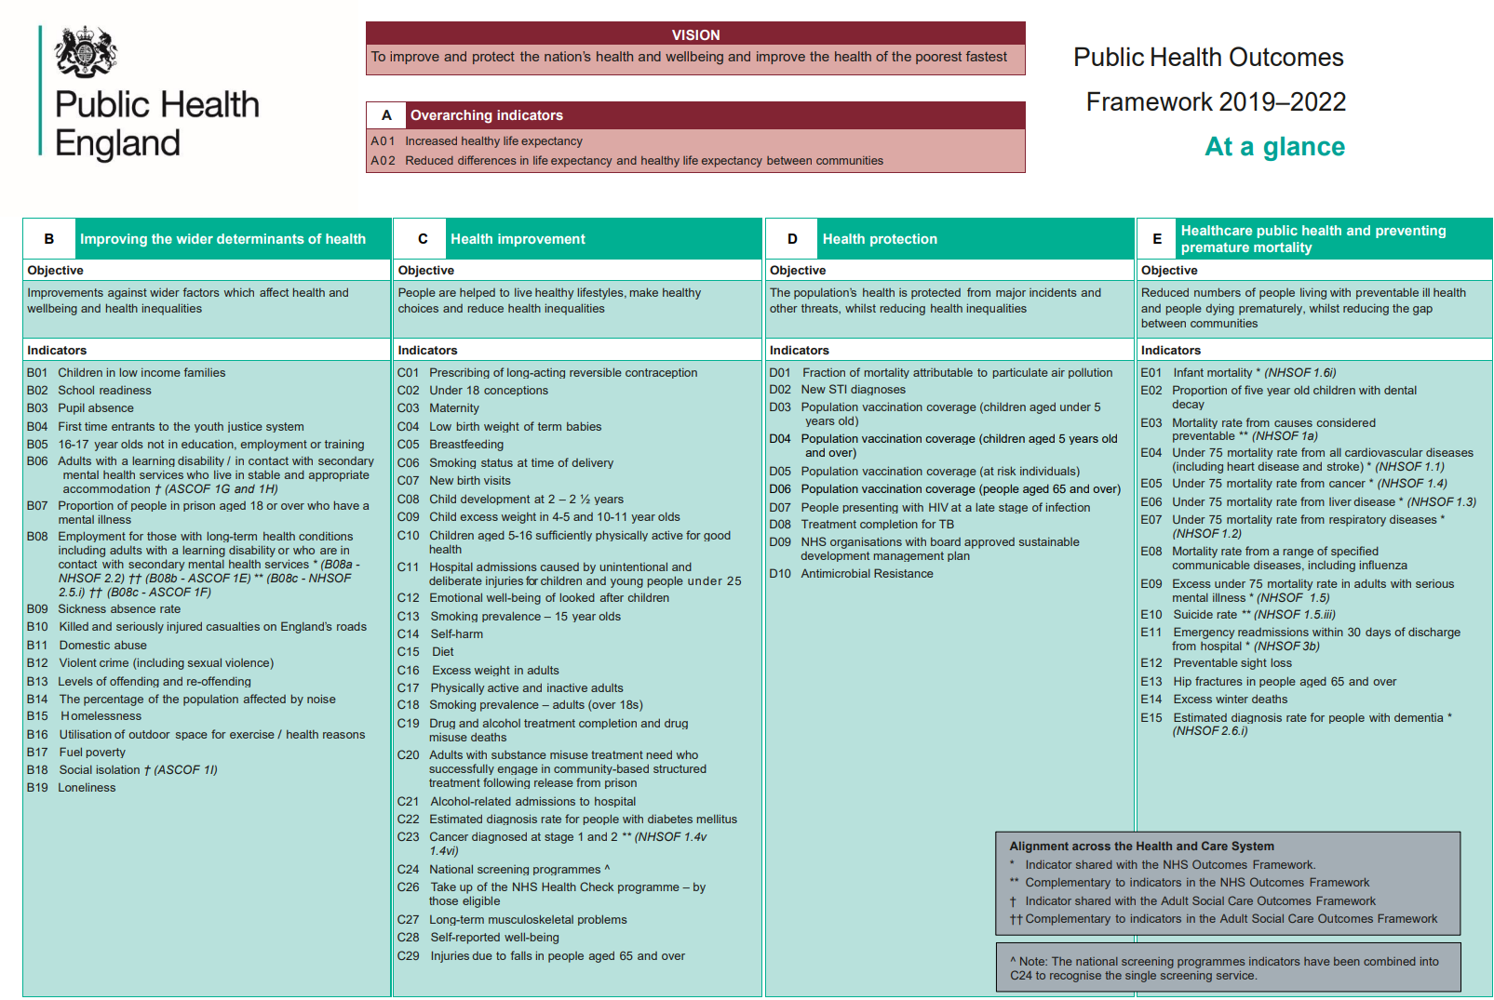

Slide 30
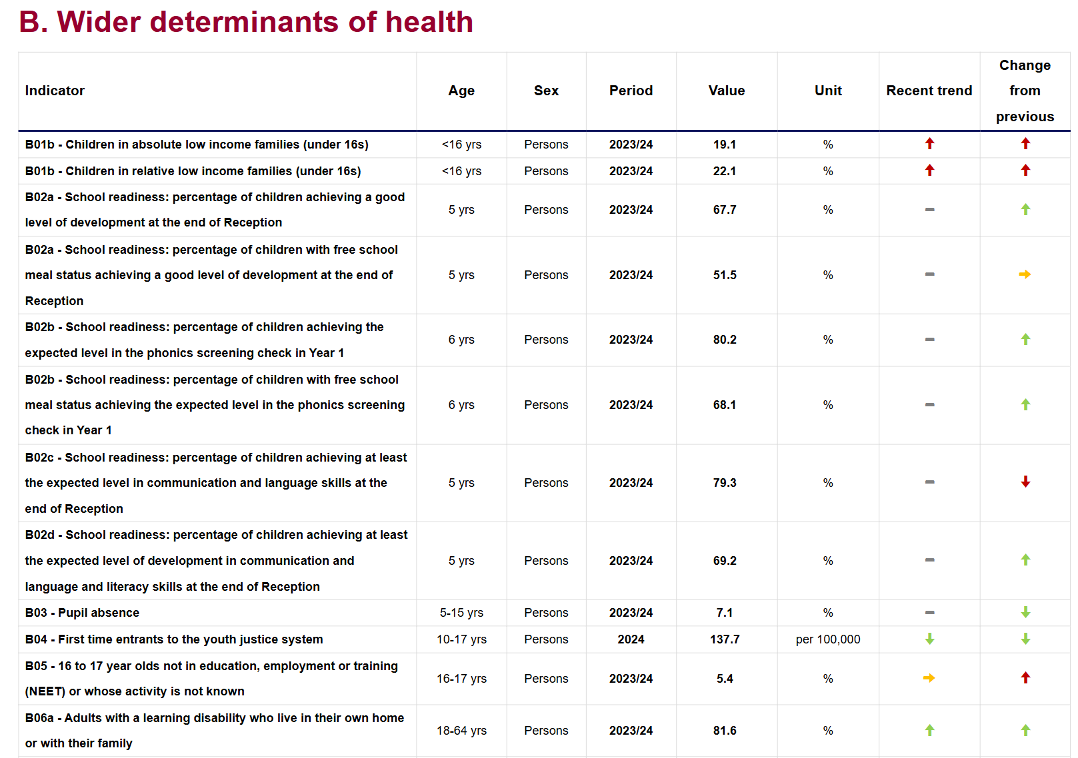
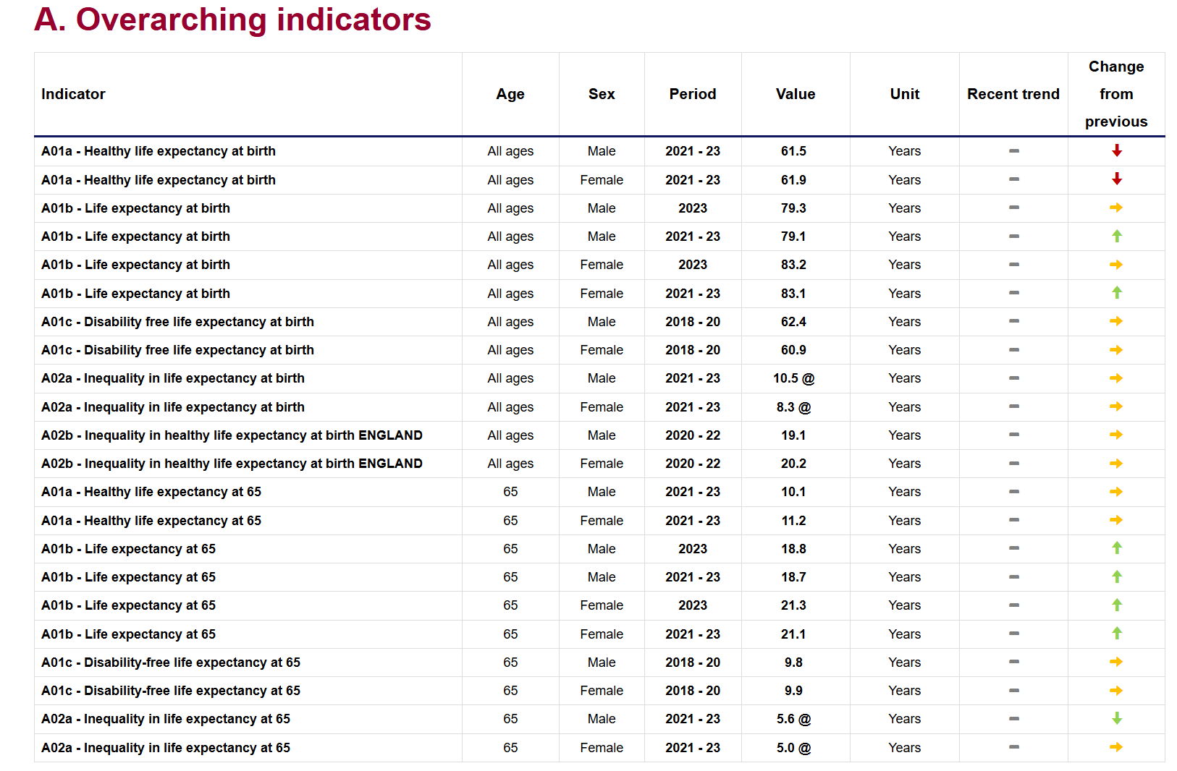
Examples of current indicators
https://fingertips.phe.org.uk/documents/Public%20Health%20Outcomes%20Framework%20at%20a%20glance%20-England%20November%202025.html
Notes:
https://assets.publishing.service.gov.uk/government/uploads/system/uploads/attachment_data/file/862264/At_a_glance_document2.pdf
https://fingertips.phe.org.uk/documents/Public%20Health%20Outcomes%20Framework%20at%20a%20glance%20-%20England%20February%202022.html

Slide 31
PHOF, local authorities & the NHS
  Local authorities:
  Indicators that best reflect local health needs (set out in JSNA and reflected in the Joint Health and Wellbeing Strategy)
  PHOF: essential tool for driving local sector-led improvement (provides data in PHOF for benchmarking)
  Accountability at local level with CCG
  NHS:
  Delivering specific health programmes e.g. immunisations/ screening, providing health improvement advice (MECC) & ↓ preventable mortality
  Example: Aim to deliver improvements against cancer screening coverage (Domain 2) & premature mortality (Domain 4)
Notes:
LA: Demonstrate improvements in ph outcomes through achieving progress against
MECC: Making every contact count

Slide 32
Domain 1: Improving wider determinants of health
Objective: Improvement against wider factors that affect health, wellbeing & health inequalities
Indicators included have a significant impact on health & wellbeing (Marmot report)
Cross-agency working essential to meets these outcomes. include:
  LA with the partners (social services/ NHS/etc); Police and criminal justice system; Schools; Employers; Business & voluntary sector

Slide 33
Domain 2: Health improvement
Focused on actions to help people make healthy choices & lead healthy lifestyles
Based on health improvement programs commissioned by LA’s
Some programs led by NHS e.g. screening service
Indicators ordered by impact through lifecourse
Many indicators linked to nutrition

Slide 34
Domain 3: Health Protection
Focused on essential actions to protect the public’s health
NHS & LA’s - role in protecting their population’s health
Domain 4: Healthcare & preventing premature mortality
Indicators delivered by the whole public health system, including LA, PHE, NHS
Shared indicators with NHS outcome framework to ensure integration

Slide 35
PHOF: Future Steps
  Last update included data for 49 indicators
  Next update due Feb 2026
  Consider:
  Is it sufficiently robust?
  Are any indicators missing?
  What do you think of the frequency of updates?

